Slide 1
Statewide Strategic Plan for Higher Education
Education Summit
HOUSE COMMITTEE ON EDUCATION
Peter Blake, SCHEV Director
November 11, 2014

Slide 2
SCHEV Purpose: § 23-9.3
Advocate, promote and coordinate higher ed
Lead state-level strategic planning, policy development and implementation
Facilitate collaboration among institutions
Work with public institutions and boards on board development

Slide 3
Rules Under Which We Operate
Code of Virginia
Authorizing statutes for each institution
Authorizing statutes for SCHEV (HB2311 of 2013)
Restructuring Act of 2005
Tops Jobs (TJ21) Act of 2011
Directives from McAuliffe Administration
Credentials that Count (Strategic Workforce Initiatives Memo from Sec. Jones, July 2014)
Executive Order 23: Establishing the New Economy Workforce Initiative (August 2014)

Slide 4
Common Responsibilities
Ensure an educated citizenry.
Place Virginia among the most highly educated states and countries.
Generate economic growth, job creation, personal income growth, and individual opportunity.
Enhance the security and economic competitiveness of the United States of America.
Promote university-based research.
Enhance institutional excellence and cost efficiency.
Realize the principles of autonomy, accountability, affordable access, and mutual trust and obligation.

Slide 5
Collaborative Engagement
Six regional meetings with students and administrators from high schools and institutions of higher education as well as business and community leaders
An invitation-only electronic survey for key stakeholders who were unavailable for regional meetings
Individual conversations and two group meetings with “key listeners” around Capitol Square
A public electronic survey (504 responses)
Regular conversations with SCHEV advisory committees (presidents–GPAC and PCAB; provosts; finance officers)
Additional interim conversations with a GPAC subgroup
Five public meetings of the State Council, plus multiple special open meetings of its Executive Committee and Strategic Planning Task Force

Slide 6
Common Issues and Challenges
Demographic Change
Economic Change
Technological Change/Disruption
Funding Change/(Un)Sustainability
Regional Differences
Federal Perspectives on Postsecondary Ed
Competitive Pressures from Other Sectors
Public Perception of Postsecondary Ed

Slide 7
Top Policy AND STRATEGIC Issues in Higher Education
Association of Governing Boards |  | American Association of State Colleges and Universities “Top 10 State Policy Issues, 2014” | NATIONAL CONFERENCE OF STATE LEGISLATURES “Higher Ed Legislation, 2014” | EDUVENTURES “Critical Issues Facing Higher Ed Leaders in 2014”
“Top Public Policy Issues, 2013-14” | “Top 10 Strategic Issues for Boards, 2013-14”
1-The Value of Higher Education | 1-The Revenue Model | 1-Harnessing Higher Ed toward State Economic Goals | 1-Affordability and Tuition | 1-The Continued Scrutiny of Higher Education
2-Mixed Messages from Policy Makers | 2-Productivity and Efficiency | 2-Agreements Linking State Funding and Tuition Policy | 2-Financial Aid | 2-The Prioritization of Outcomes
3-Constraints in Institution Support | 3-Student Aid | 3-Allocation of State Higher Ed Appropriations | 3-Outcomes-based Funding | 3-The Retention Culture
4-The Future of Student Aid | 4-Educational Delivery | 4-State Educational Attainment & College Completion Goals | 4-Distance Education and Reciprocity Agreements | 4-The Blended-learning Opportunity
5-Student Attainment | 5-Student Learning | 5-Vocational and Technical Education | 5-Student Veterans | 5-The Regionalization of Online Higher Ed
6-Quality Assurance | 6-Student Success | 6-College Readiness | 6-Educational Attainment and Workforce Development
7-Tax Policy | 7-Market & Mission | 7-STEM-related Initiatives | 7-Dual Enrollment
 | 8-The Academic Workforce | 8-State Capital Outlay and Deferred Maintenance Funds
 | 9-Globalization | 9-Guns on Campus
 | 10-Institutional Risk | 10-Immigration

Slide 8
GOALS OF THE STATEWIDE STRATEGIIC PLAN
GOAL 1: Provide Affordable Access for All
GOAL 2: Optimize Student Success for Work and Life
GOAL 3: Drive Change and Improvement through Innovation and Investment
GOAL 4: Advance the Economic and Cultural Prosperity of the Common-wealth and its Regions

Slide 9
M I S S I O N
Higher education in Virginia will advance postsecondary learning, research and public service that enhance the civic and financial health of the Commonwealth and the well-being of all its people.

Slide 10
Higher Education will transform the lives of Virginians, our communities and our Commonwealth.
VISION

Slide 11
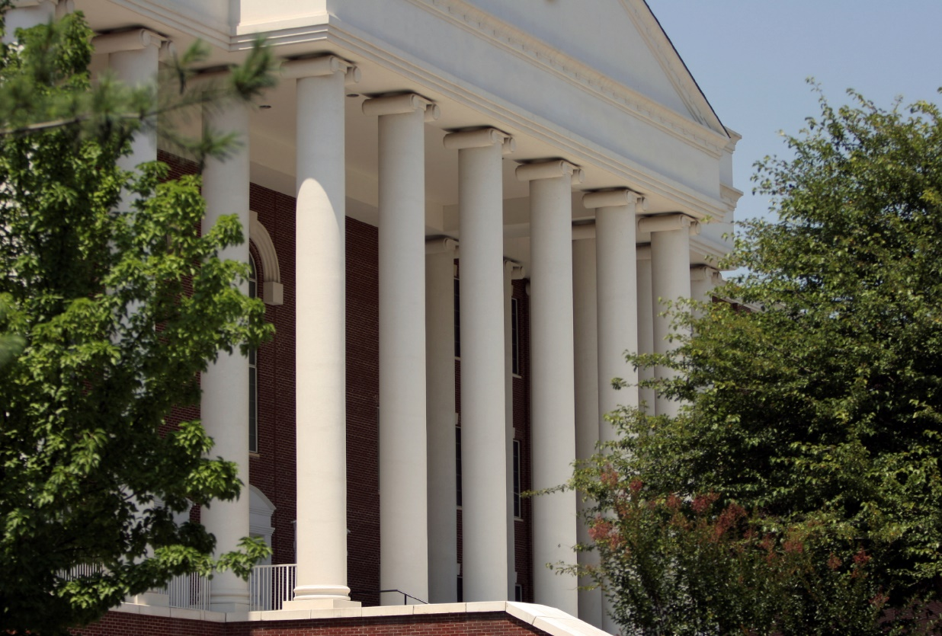
Higher education in Virginia will advance postsecondary learning, research and public service that enhance the civic and financial health of the Commonwealth and the well-being of all its people.
GOAL 1
Provide Affordable
Access
for All
GOAL 2
Optimize Student Success for Work and Life
GOAL 3
Drive Change and Improvement through Investment and Innovation
GOAL 4
Advance the Economic and Cultural Prosperity of the Commonwealth and its Regions
Mission, Vision, and Goals approved by Council on 09.16.2014

Slide 12
Higher education in Virginia will advance postsecondary learning, research and public service that enhance the civic and financial health of the Commonwealth and the well-being of all its people.
GOAL 1
Provide Affordable
Access
for All
GOAL 2
Optimize Student Success for Work and Life
GOAL 3
Drive Change and Improvement through Investment and Innovation
GOAL 4
Advance the Economic and Cultural Prosperity of the Commonwealth and its Regions
Goal-Level Measure and Target
Strategies
(approved by Council on 10.28.2014)

Slide 13
GOAL: Provide Affordable Access for All
Strategies:
1.1 Expand outreach to PK-12 and traditionally underserved populations
1.2 Improve the college readiness of all students
1.3 Cultivate affordable postsecondary education pathways for traditional, non-
traditional and returning students
1.4 Align state appropriations, financial aid and tuition and fees such that students
have broader access to postsecondary education opportunities regardless of their
ability to pay
Options for Goal-level Measures:
Total student enrollment and traditionally-underserved-population enrollment
Student-loan debt of graduates
Cost of undergraduate tuition per capita of disposable income
1

Slide 14
2
Options for Goal-level Measures:
Number of students who complete their credentials on-time
Student retention, transfer and completion
Virginia’s level of postsecondary educational attainment
GOAL: Optimize Student Success for Work and Life
Strategies:
2.1 Strengthen curricular options to ensure that graduates are prepared with the
competencies necessary for employment and civic engagement
2.2 Provide effective academic and student services infrastructures focused on
persistence and completion
2.3 Increase on-time completion of certificates and degrees
2.4 Engage adults and veterans in certificate and degree completion and lifelong
learning

Slide 15
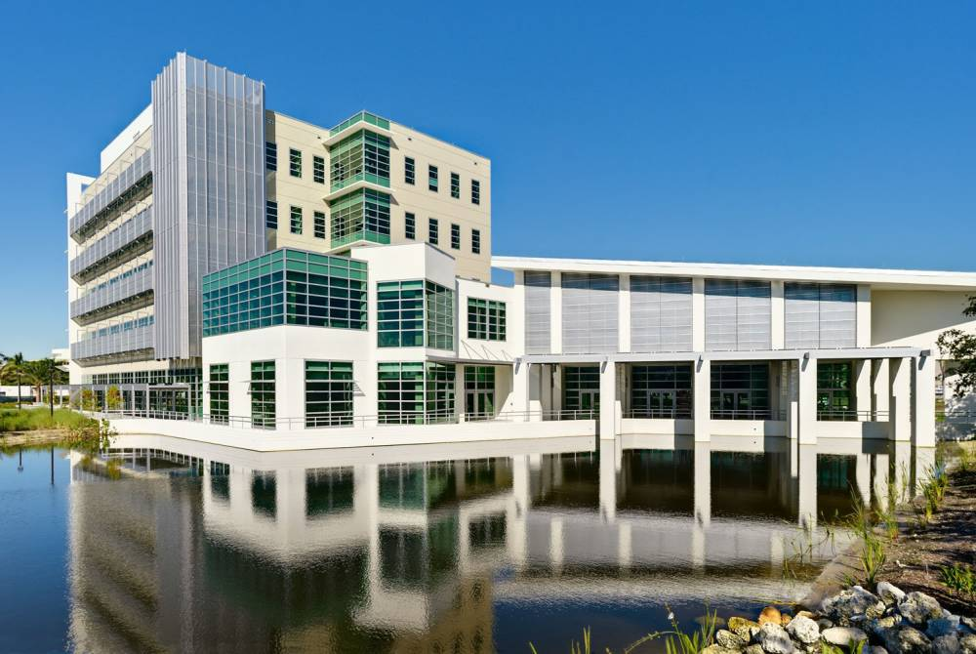
GOAL: Drive Change and Improvement through Investment and Innovation
Strategies:
3.1 Identify and implement public funding strategies to sustain long-term planning
and responsiveness
3.2 Cultivate innovations that enrich quality, promote collaboration and improve
efficiency
3.3 Foster faculty excellence, scholarship and diversity
3.4 Enhance higher education leadership, governance and accountability
3
Options for Goal-level Measures:
Number of institutions conducting reviews of academic, administrative or organizational policies and processes
Number of institutions meeting institutional performance standards (publics only) and accreditation requirements (all)

Slide 16
4
Options for Goal-level Measures:
Earnings of graduates, by region
Virginia’s rank on “best state for” ratings
Academic-research expenditures
Strategies:
4.1 Build a competitive, future-ready workforce for all regions
4.2 Be a catalyst for entrepreneurship and a model for
business incubation
4.3 Target funding, resources and partnerships to support
research and development
4.4 Expand participation and engagement in public service
and institutional service to the community
4.5 Demonstrate the impact of higher education on state and
regional economic development
GOAL: Advance the Economic and Cultural Prosperity of the Commonwealth
and its Regions

Slide 17
www.schev.edu/schev/StrategicPlan.asp
peterblake@schev.edu

